Slide 1


NETWORKING FUNDAMENTALS

Slide 2





COURSE OUTLINE
WHAT IS A NETWORK
NETWORK TYPES
NETWORK TOPOLOGIES
NETWORK DEVICES
NETWORK PROTOCOLS

Slide 3
COURSE OUTLINE
NETWORK PORTS
NETWORKING MODELS
NETWORK TOPOLOGIES
NETWORK DEVICES
NETWORK PROTOCOLS

Slide 4

COURSE OBJECTIVE.
Describe the function and operation of network devices.
Describe the functionality of networks
Identify the possible media types for network connections
Describe the differences between Networks.
List the different network protocols and network standards.
Describe network communication concepts like the TCP/IP model, OSI model,DNS, and ports.

Slide 5
COURSE OUTLINE
Taking on a role as a pen tester requires knowing the foundations for how networking works, and how to use different devices to build networks. You'll also need to secure your network to protect your organization's assets and resources.
In this module, you'll explore how networks communicate with each other. You'll also learn about network protocols and standards and the difference between networks.

Slide 6
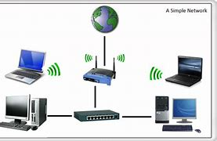
WHAT IS A NETWORK
A network refers to two or more connected computers that can share resources such as data, a printer, an Internet connection, applications, or a combination of these resources.

Slide 7


NETWORK TYPES.

Slide 8
NETWORK TYPES.
Networks vary in size, shape, and usage. To make it easier to identify different network types, they're categorized into one of the following network categories:
Personal area networks
Local area networks
Metropolitan area networks
Wide area networks

Slide 9
NETWORK TYPES CONT…
Personal area network?
A personal area network (PAN) provides networking needs around an individual.
An example of a PAN is where a smartphone, smartwatch, tablet, and laptop all connect and share data without the need to connect to an access point or other third-party network services.
PAN networks typically use Bluetooth to communicate because it provides a low-power, short-range data-sharing capability. The network standards associated with a PAN are Bluetooth and IEEE 802.15.

Slide 10
NETWORK TYPES CONT…
Local area network?
A local area network (LAN) provides networking needs around a single location. This location might be an organization's office, a school, a university, a hospital, an airport, and many others.
A LAN is usually privately owned and needs authentication and authorization to access. Of the different classifications of a network, a LAN is by far the most commonly used.

Slide 11
NETWORK TYPES CONT…
Metropolitan area network?
A metropolitan area network (MAN) provides networking capabilities between two different locations within a city or metropolitan area to provide a single extensive network.
Typically, a MAN requires a dedicated and secure connection between each LAN joined to the MAN.

Slide 12
NETWORK TYPES CONT…
Wide area network?
A wide area network (WAN) provides networking capabilities between two different geographical locations locally or worldwide.
For example, a WAN is used to connect an organization's head office with branch offices all over the country.
A WAN links multiple LANs together to create one super network. As a MAN, you use a virtual private network (VPN) to manage the connection between different LANs.

Slide 13
NETWORK TYPES CONT…
Differences between LAN and WAN networks
LAN | WAN
A LAN is a privately operated network typically contained in a single building. | A WAN is used to connected geographically separate offices to each other. Multiple organizations might operate WANs.
A LAN operates at speeds of 10 Gbps or higher. | A WAN typically operates at speeds of less than 1 Gbps.
A LAN is less congested compared to other network types. | A WAN is more congested compared to other network types.
A LAN can be managed and administrated in-house. | A WAN typically requires the use of a third party to configure and set up, which increases cost.

Slide 14
NETWORK TYPES CONT…
Networks are defined by a particular or combination of topologies. A network topology is all about the positioning of a network, including its nodes and relating lines.

Slide 15


NETWORK TOPOLOGIES.

Slide 16
NETWORK TOPOLOGIES.
A network topology describes the physical composition of a network.
Let's look at four topologies you can choose from when you design a LAN. They are:
Bus
Ring
Mesh
Star

Slide 17
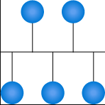
NETWORK TOPOLOGIES CONT…
Bus topology
In a bus topology, each network device is connected to a single network cable.

Slide 18
NETWORK TOPOLOGIES CONT…
Bus topology
Even though it's the simplest type of network to implement, there are limitations to it.
The first limitation is the length of the main cable or bus. The longer it gets, the higher the chance of signal dropout. This limitation constrains the physical layout of the network.
Secondly, if there's a break in the bus cable, the whole network fails.
All devices have to be physically located near each other, for example, in the same room.

Slide 19
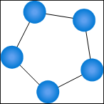
NETWORK TOPOLOGIES CONT…
Ring topology
In a ring topology, each network device is connected to its neighbor to form a ring.
This form of network is more resilient than the bus topology.
A break in the cable ring also affects the performance of the network.

Slide 20
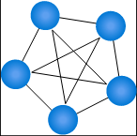
NETWORK TOPOLOGIES CONT…
Mesh topology
The mesh topology is described as either
a physical mesh
a logical mesh.

Slide 21
NETWORK TOPOLOGIES CONT…
Mesh topology
Physical mesh,
Each network device connects to every other network device in the network.
It dramatically increases the resilience of a network but has the physical overhead of connecting all devices.

Slide 22
NETWORK TOPOLOGIES CONT…
Mesh topology
Logical mesh,
Most modern networks are mesh based, since each device can see and communicate with any other device on the network. This description is of a logical mesh network and is primarily made possible through the use of network protocols.

Slide 23
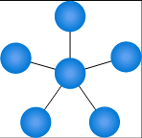
NETWORK TOPOLOGIES CONT…
Star topology
The star topology is the most commonly used network topology.
Each network device connects to a centralized hub or switch.
Switches and hubs can be linked together to extend and build more extensive networks.
This type of typology is, by far, the most robust and scalable.

Slide 24

NETWORK DEVICES.

Slide 25
NETWORK DEVICES.
On network devices we discuss the standards enabling interoperability of the devices and infrastructure where will learn about the devices.
Network standards.
Network infrastructure.

Slide 26
NETWORK STANDARDS.

Slide 27
NETWORK STANDARDS.
Network standards provide a framework that enables the interoperability between devices.
Network standards improve the interoperability of different network-enabled devices and provide backward compatibility between product revisions and differing vendors.

Slide 28
NETWORK STANDARDS CONT...
Network standards govern the hardware and software that uses them.
Today, there are hundreds of thousands of hardware suppliers, yet all of their technology seamlessly integrates with your computer or network with minimal effort.

Slide 29
NETWORK STANDARDS CONT...
Official bodies that publish regulated standards are the International Telecommunication Union (ITU), the American National Standards Institute (ANSI), and the Institute of Electrical and Electronics Engineers (IEEE).
It would be impossible to build networks and connect network-enabled devices reliably without network standards.

Slide 30
NETWORK STANDARDS CONT...
THE 802 FAMILY OF STANDARDS
The 802 specification covers all the physical networking standards for both Ethernet and wireless.

Slide 31
NETWORK STANDARDS CONT...
THE 802 FAMILY OF STANDARDS.
The following table shows some of the more widely used standards.
802 | Overview | Basics of physical and logical networking concepts
802.1 | Bridging | LAN/MAN bridging and management of the lower sublayers of OSI Layer 2
802.2 | Logical Link | Commonly referred to as the logical link control (LLC) specification
802.3 | Ethernet | Provides asynchronous networking by using carrier sense, multiple accesses with collision detect (CSMA/CD) over coaxial cable, twisted-pair copper cable, and fiber media
802.5 | Token ring | The token-passing standard for shielded copper cables and twisted-pair cable

Slide 32
NETWORK STANDARDS CONT...
THE 802 FAMILY OF STANDARDS
The following table shows some of the more widely used standards.
802 | Overview | Basics of physical and logical networking concepts
802.11 | Wi-Fi | Wireless local area network (WLAN) media access control (MAC) and physical layer (PHY) specification
802.11a | Wi-Fi | Specifies a PHY that operates in 5 GHz
802.11b | Wi-Fi | Enhances 802.11, adds higher data rate modes
802.11d | Wi-Fi | Enhances 802.11a/b, allows for global roaming
802.11e | Wi-Fi | Enhances 802.11, adds Quality of Service (QoS) features

Slide 33
NETWORK STANDARDS CONT...
THE 802 FAMILY OF STANDARDS
The following table shows some of the more widely used standards.
802 | Overview | Basics of physical and logical networking concepts
802.11 h | Wi-Fi | Enhances 802.11a, now resolves interference issues
802.11i | Wi-Fi | Enhances 802.11, adds security for WLAN applications
802.11j | Wi-Fi | Enhances 802.11a for Japanese regulatory extensions
802.11n | Wi-Fi | Higher-speed standards
802.11g | Wi-Fi | Extends WLAN maximum data rate

Slide 34
NETWORK STANDARDS CONT...
THE 802 FAMILY OF STANDARDS
The following table shows some of the more widely used standards.
802 | Overview | Basics of physical and logical networking concepts
802.15.1 | Bluetooth | Short-range (10 m) wireless technology
802.15.3a | UWB | Short-range, high-bandwidth ultra-wideband (UWB) link
802.15.4 | ZigBee | Short-range wireless sensor networks
802.16 | Wireless metropolitan area networks | Covers mobile and wireless broadband access in wireless metropolitan area networks (WMANs)
802.15.1 | Bluetooth | Short-range (10 m) wireless technology
802.12 | Demand Priority | Ethernet data rate increased to 100 Mbps

Slide 35
NETWORK STANDARDS.
A network can't exist unless each of the devices has the means of communicating with another. This fact applies whether it's your organization's network or more extensive networks like the web.

Slide 36

NETWORK INFRASTRUCTURE.

Slide 37

NETWORK INFRASTRUCTURE.
There are several network standard-compliant devices that make up the structure of your networks. Depending on the network's size, you might use several of these devices to build the backbone of your network.
These devices are:
Repeaters
Hubs
Bridges
Switches
Routers

Slide 38
NETWORK INFRASTRUCTURE CONT...
Nearly all of these devices depend on a media access control or an Internet Protocol (IP) address to deliver data on the network.
What is a media access control address?
The media access control (MAC) address is a unique identifier assigned to every network-enabled device at the time of manufacture.
It's sometimes referred to as the burnt-in address, the Ethernet hardware address, or a physical address.

Slide 39
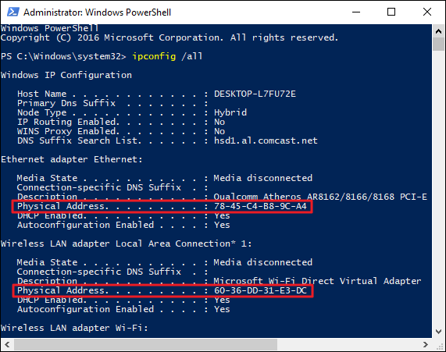
NETWORK INFRASTRUCTURE CONT...
The MAC address has a standard composition of six hexadecimal numbers separated by a colon or dash.
The first three numbers of the MAC address define the manufacturer's organizationally unique identifier (OUI) and the remaining three numbers uniquely identify the device.
For example, if the MAC address is AA-6A-BA-2B-68-C1 then the OUI is AA-6A-BA and 2B-68-C1 is the device ID.

Slide 40
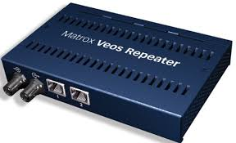
NETWORK INFRASTRUCTURE CONT...
REPEATER
A repeater is a two-port device that repeats network signals. Repeaters are used when network devices are some distance from each other.

Slide 41
NETWORK INFRASTRUCTURE CONT...
REPEATER
A repeater doesn't modify or interpret data packets before it resends them, and it doesn't amplify the signal. Instead, it regenerates the data packet at the original strength, bit by bit.

Slide 42
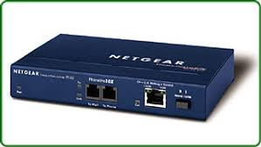
NETWORK INFRASTRUCTURE CONT...
BRIDGE.
A bridge divides a network into network segments and can filter and forward data packets between these segments.

Slide 43
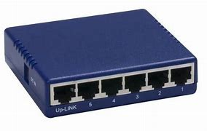
NETWORK INFRASTRUCTURE CONT...
Hub
A hub acts as a multiport repeater on a network. Hubs are used to connect more than one device and structure the layout of a network.
Hubs contain multiple ports that act as an input/output Ethernet connection between the hub and a network device.

Slide 44
NETWORK INFRASTRUCTURE CONT...
Hub
A hub can operate at only one speed, which is the speed of the slowest network device on the network. It doesn't interpret or filter data packets and sends copies of each data packet to all attached devices.

Slide 45
NETWORK INFRASTRUCTURE CONT...
Types of hubs
Fast Ethernet:
Dual speed:

Slide 46
NETWORK INFRASTRUCTURE CONT...
Types of hubs
Fast Ethernet:
This hub is used for 100-Mbps networks and comes as Class I and Class II type hubs. The primary difference between the two is the amount of delay in data transmission.

Slide 47
NETWORK INFRASTRUCTURE CONT...
Types of hubs
Fast Ethernet:
A Class I hub introduces a signal delay of up to 140-bit times. A Class II hub has a delay of up to 96-bit times. The delay allows for the transcoding of data between different base types.
Only two Class II hubs can be used in a hub-based network. Class II hubs increase the likelihood of packet collisions because of their higher speeds.

Slide 48
NETWORK INFRASTRUCTURE CONT...
Types of hubs
Dual speed
With a traditional hub network, the speed of the network was governed by the slowest network device attached. For example, if you had 10-Mbps and 100-Mbps devices connected to a network, the speed of the whole network was only 10 Mbps.
Dual-speed hubs solve the problem by acting as a bridge between the two different-speed devices.
Hubs are used for small ad-hoc networks of a few devices, but they're rarely used at an enterprise level.

Slide 49
NETWORK INFRASTRUCTURE CONT...
Hubs
Hubs are used for small ad-hoc networks of a few devices, but they're rarely used at an enterprise level.

Slide 50
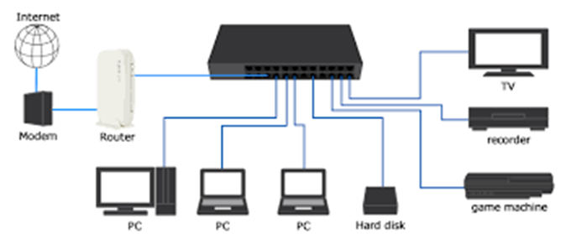
NETWORK INFRASTRUCTURE CONT...
SWITCH
Switch
A switch combines the functionality of a bridge and a hub. It segments networks and can interpret and filter packet data to send it directly to an attached network device.

Slide 51
NETWORK INFRASTRUCTURE CONT...
SWITCH
Switch
Switches use the network device's MAC address to decide the data package's destination. A switch operates in full-duplex mode, which means it can send and receive data to and from network devices at the same time.

Slide 52
NETWORK INFRASTRUCTURE CONT...
SWITCH
Switch
Features
Modern Ethernet-based switches offer more functionality and capabilities than an Ethernet hub.
An Ethernet switch can adjust the connection speed of an inbound packet to match the connection speed of the destination network.
Many switches now support Power over Ethernet (PoE). PoE enables network devices like Voice over IP (VoIP) phones to get power from the switch, without needing a separate power supply.
Other modules can be attached to the switch to enable functions like port mirroring, packet sniffers, and intrusion detection systems.

Slide 53
NETWORK INFRASTRUCTURE CONT...
TYPES OF ETHERNET SWITCH
Types of Ethernet switch
There are two types of switch's:
Unmanaged
Managed

Slide 54
NETWORK INFRASTRUCTURE CONT...
TYPES OF ETHERNET SWITCH
Types of Ethernet switch
Unmanaged
This type of switch has no configuration capability and is designed for small office or home office environments. Packet switching occurs automatically.

Slide 55
NETWORK INFRASTRUCTURE CONT...
TYPES OF ETHERNET SWITCH
Types of Ethernet switch
Managed
This type of switch offers the means to adjust the configuration, behavior, and operation of the switch.
Access to the switch configuration is either through a command-line interface (CLI) that uses Telnet or Secure Shell (SSH), Remote Console, or via a web interface.

Slide 56
NETWORK INFRASTRUCTURE CONT...
TYPES OF ETHERNET SWITCH
Types of Ethernet switch
Managed
There are two subtypes of managed switch:
Smart
Enterprise

Slide 57
NETWORK INFRASTRUCTURE CONT...
TYPES OF ETHERNET SWITCH
Managed
There are two subtypes of managed switch:
Smart: A smart switch is a halfway point between an unmanaged and a managed switch. They tend to offer only a web-based interface to manage the configuration.

Slide 58
NETWORK INFRASTRUCTURE CONT...
TYPES OF ETHERNET SWITCH
Managed
There are two subtypes of managed switch:
Enterprise: The fully managed switch service previously described.

Slide 59
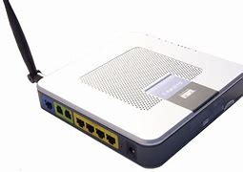
NETWORK INFRASTRUCTURE CONT...
ROUTER
Routers link networks with different ranged addresses together. They can interpret and filter data packets, and then forward them to the correct network.
Routers use the network device's IP address information to route the data package to its destination.

Slide 60
NETWORK INFRASTRUCTURE CONT...
ROUTER
Router
Most routers can now detect issues with data traffic that flows to any attached network and route or reroute it around the issue. A router is also called a gateway.
When you configure network devices, you'll usually configure it with a default gateway IP address.

Slide 61
NETWORK INFRASTRUCTURE CONT...
ROUTER
Router
Routers in an interconnected network maintain a routing table that lists the preferred route between each of the networks.
The router acts as the start of authority for all the network devices on its network.
Routing information is shared between routers by using a routing protocol like the Border Gateway Protocol (BGP).

Slide 62
NETWORK INFRASTRUCTURE CONT...
The first step in understanding the composition of a network is to understand how network devices communicate with each other. This knowledge applies to your organization's network and to more extensive networks like the web. The same principles apply to all networks.
Next you'll learn about the essential network protocols and ports that enable communication across internet-based networks.

Slide 63

NETWORK PROTOCOLS CONT...
NETWORK PROTOCOLS
A network protocol is a set of conditions and rules that specify how network devices communicate on a given network.
It provides a common framework for establishing and maintaining a communications channel, and how to handle errors or faults should they occur.

Slide 64
NETWORK PROTOCOLS CONT...
NETWORK PROTOCOLS
Network protocols allow communication between different network-enabled devices, for example, laptops, tablets, smartphones, desktops, servers, and other network-enabled devices.

Slide 65
NETWORK PROTOCOLS CONT...
NETWORK PROTOCOLS
The network protocol is an essential building block in the design of an organization's network architecture.
There are many network protocols available.
Each network protocol has many properties that govern its use and implementation.

Slide 66
NETWORK PROTOCOLS CONT...
Let's define a few terms before we look at some of the commonly used network protocols.

Slide 67
NETWORK PROTOCOLS CONT...
First, we need to define three foundational protocols of all internet-based networks.
These three protocols are Transmission Control Protocol (TCP), Internet Protocol (IP), and User Datagram Protocol (UDP).
These protocols are concerned with the logical transmission of data over the network.

Slide 68
NETWORK PROTOCOLS CONT...
Transmission Control Protocol:
TCP chunks up data into data packets that can be sent securely and quickly while minimizing the chance of data loss.
It provides a stable and reliable mechanism for the delivery of data packets across an IP-based network.
Even though TCP is an effective connection-oriented protocol, it has overhead.

Slide 69
NETWORK PROTOCOLS CONT...
Internet Protocol:
IP is responsible for the addressing of a data packet. IP encapsulates the data packet to be delivered and adds an address header.
The header contains information on the sender and recipient IP addresses. This protocol isn't concerned about the order in which the packets are sent or received.
It also doesn't guarantee that a packet will be delivered, only the address.

Slide 70
NETWORK PROTOCOLS CONT...
User Datagram Protocol:
UDP is a connectionless protocol that offers a low-latency and loss-tolerant implementation.
UDP is used with processes that don't need to verify that the recipient device received a datagram.

Slide 71
NETWORK PROTOCOLS CONT...
Protocol categories
Several types of applications and hardware devices depend on specific network protocols on a typical network.
For example, browsing the internet by using a web browser relies on a different protocol than sending or receiving an email. Converting the data that you see in the browser and sending this information over the network requires another protocol.

Slide 72
NETWORK PROTOCOLS CONT...
Protocol categories
Protocols fall into three categories:
Network communication protocols
Network security protocols
Network management protocols
Let's have a look at some of the protocols in these categories.

Slide 73
NETWORK PROTOCOLS CONT...
Protocol categories
Network communication protocols
Communication protocols focus on establishing and maintaining a connection between devices.
As you work with different devices and network services, you'll make use of various network communication protocols.

Slide 74
NETWORK PROTOCOLS CONT...
Protocol categories
Network communication protocols
The rest of the protocols that we'll discuss here are based on a type of application, for example, an email client or a web browser.

Slide 75
NETWORK PROTOCOLS CONT...
Protocol categories
Network communication protocols
Here are the most commonly used network communication protocols:
Hypertext Transfer Protocol (HTTP)
File Transfer Protocol (FTP)
Post Office Protocol 3 (POP3)
Simple Mail Transfer Protocol (SMTP)
Interactive Mail Access Protocol (IMAP)

Slide 76
NETWORK PROTOCOLS CONT...
Protocol categories
Network communication protocols
Hypertext Transfer Protocol (HTTP):
The HTTP protocol uses TCP/IP to deliver web page content from a server to your browser.
HTTP can also handle the download and upload of files from remote servers.

Slide 77
NETWORK PROTOCOLS CONT...
Protocol categories
Network communication protocols
File Transfer Protocol (FTP):
FTP is used to transfer files between different computers on a network. Typically, FTP is used to upload files to a server from a remote location.
While you can use FTP to download files, web-based downloads are typically handled through HTTP.

Slide 78
NETWORK PROTOCOLS CONT...
Protocol categories
Network communication protocols
Post Office Protocol 3 (POP3):
POP3 is one of three email protocols.
It's most commonly used by an email client to allow you to receive emails. This protocol uses TCP for the management and delivery of an email.

Slide 79
NETWORK PROTOCOLS CONT...
Protocol categories
Network communication protocols
Simple Mail Transfer Protocol (SMTP):
SMTP is another one of the three email protocols. It's most commonly used to send emails from an email client via an email server.
This protocol uses the TCP for management and transmission of the email.

Slide 80
NETWORK PROTOCOLS CONT...
Protocol categories
Network communication protocols
Interactive Mail Access Protocol (IMAP):
IMAP is the more powerful of the three email protocols.
With IMAP and an email client, you can manage a single mailbox on an email server in your organization.

Slide 81
NETWORK PROTOCOLS CONT...
Protocol categories
Network security protocols
Network security protocols are designed to maintain the security and network of data across your network. These protocols encrypt in-transmission messages between users, services, and applications.
Network security protocols use encryption and cryptographic principles to secure messages.

Slide 82
NETWORK PROTOCOLS CONT...
Protocol categories
Network security protocols
To implement a secure network, you must match the right security protocols for your needs.
The following list explores the leading network security protocols:
Secure Socket Layer (SSL)
Transport Layer Security (TLS)
Hypertext Transfer Protocol Secure (HTTPS)
Secure Shell (SSH)
Kerberos

Slide 83
NETWORK PROTOCOLS CONT...
Protocol categories
Network security protocols
Secure Socket Layer (SSL):
SSL is a standard encryption and security protocol.
It provides a secure and encrypted connection between your computer and the target server or device that you accessed over the internet.

Slide 84
NETWORK PROTOCOLS CONT...
Protocol categories
Network security protocols
Transport Layer Security (TLS):
TLS is the successor to SSL and provides a stronger and more robust security encryption protocol.
Based on the Internet Engineering Task Force (IETF) standard, it's designed to stop message forgery and tampering and eavesdropping.
It's typically used to protect web browser communications, email, VoIP, and instant messaging.
While TLS is now used, the replacement security protocol is often still called SSL.

Slide 85
NETWORK PROTOCOLS CONT...
Protocol categories
Network security protocols
Hypertext Transfer Protocol Secure (HTTPS):
HTTPS provides a more secure version of the standard HTTP protocol by using the TLS or SSL encryption standard.
This combination of protocols ensures that all data transmitted between the server and the web browser is encrypted and secure from eavesdropping or data packet sniffing.
The same principle is applied to the POP, SMTP, and IMAP protocols listed previously to create secure versions known as POPS, SMTPS, and IMAPS.

Slide 86
NETWORK PROTOCOLS CONT...
Protocol categories
Network security protocols
Secure Shell (SSH):
SSH is a cryptographic network security protocol that provides a secure data connection across a network.
SSH is designed to support command-line execution of instructions, which includes remote authentication to servers. FTP uses many of the SSH functions to provide a secure file transfer mechanism.

Slide 87
NETWORK PROTOCOLS CONT...
Protocol categories
Network security protocols
Kerberos:
This validation protocol provides a robust authentication for client-server-based applications through secret-key cryptography.
Kerberos assumes that all endpoints in the network are insecure. It enforces strong encryption for all communications and data at all times.

Slide 88
NETWORK PROTOCOLS CONT...
Protocol categories
Network management protocols
In your network, it's perfectly acceptable to have multiple different protocols running concurrently. The focus of this type of protocol is the sustainability of the network by looking at faults and performance.
Network administrators need to monitor their networks and any devices attached to them. Each device in your network exposes some indicators about the state and health of the device. These indicators are requested by the network administrator tool and can be used for monitoring and reporting.

Slide 89
NETWORK PROTOCOLS CONT...
Protocol categories
Network management protocols
There are two network management protocols are available:
Simple Network Management Protocol (SNMP)
Internet Control Message Protocol (ICMP)

Slide 90
NETWORK PROTOCOLS CONT...
Protocol categories
Network management protocols
Simple Network Management Protocol (SNMP):
SNMP is an internet protocol that allows for the collection of data from devices on your network and the management of those devices.
The device has to support SNMP to gather information. Devices that typically support SNMP include switches, routers, servers, laptops, desktops, and printers.

Slide 91
NETWORK PROTOCOLS CONT...
Protocol categories
Network management protocols
Internet Control Message Protocol (ICMP):
ICMP allows network-connected devices to send warning and error messages, along with operation information about the success or failure of a connection request, or if a service is unavailable.
Unlike other network transport protocols like UDP and TCP, ICMP isn't used to send or receive data from devices on the network.

Slide 92
NETWORK PROTOCOLS CONT...
Protocols are mapped to ports which are logical access channel for communication between two devices.

Slide 93
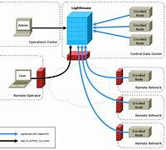
NETWORK PORTS.

Slide 94
NETWORK PORTS.
A port is a logical construct that allows the routing of incoming messages to specific processes.
A port is an unsigned 16-bit number in the range 0 to 65535 and is also known as a port number.
Ports are assigned by the sending TCP or UDP layer based on the communications protocol used.

Slide 95
NETWORK PORTS CONT...
There are specific port numbers reserved for every service. The first 1,024 ports, called the well-known port numbers, are reserved for the commonly used services.
The high-numbered ports, called the ephemeral ports, are unreserved and used by dedicated applications.

Slide 96
NETWORK PORTS CONT...
There are three ranges of ports: the well-known ports, the registered ports, and the dynamic/private ports.
The Well Known ports: 0 to 1023
The Registered ports: 1024 to 49151
The Dynamic and/or Private ports: 49152 to 65535

Slide 97
NETWORK PORTS CONT...
The Internet Assigned Numbers Authority (IANA) manages the allocation of port numbers, the regional assignment of IP addresses, and Domain Name System (DNS) root zones.
IANA also manages a central repository for protocol names and the registry used in internet protocols.

Slide 98
NETWORK PORTS CONT...
The following table lists some of the more common well-known port numbers.
Port number | Assignment
20 | File Transfer Protocol for data transfer
21 | File Transfer Protocol for command control
22 | Secure Shell for secure authentication
23 | Telnet remote authentication service for unencrypted text messages

Slide 99
NETWORK PORTS CONT...
The following table lists some of the more common well-known port numbers.
Port number | Assignment
25 | Simple Mail Transfer Protocol for email routing
53 | Domain Name System service
80 | Hypertext Transfer Protocol for use in the web
110 | Post Office Protocol

Slide 100
NETWORK PORTS CONT...
The following table lists some of the more common well-known port numbers.
Port number | Assignment
123 | Network Time Protocol (NTP)
143 | Internet Message Access Protocol for management of digital mail
161 | Simple Network Management Protocol
194 | Internet Relay Chat (IRC)
443 | HTTP Secure HTTP over TLS/SSL

Slide 101
NETWORK PORTS.
Every port links to a specific service or communications protocol.
It means that the target network device, say a server, can receive multiple requests on each port and service each of them without conflict.

Slide 102
NETWORKING MODEL.

Slide 103
NETWORKING MODEL.
For data communication to take place and two or more users to transmit data from one to other, a systematic approach is required.
This approach enables users to communicate and transmit data through efficient and ordered path. It is implemented using models in networks and are known as network models.

Slide 104
NETWORKING MODEL CONT…
Computer network models are responsible for establishing a connection among the sender and receiver and transmitting the data in a smooth manner respectively.
There are two computer network models i.e. OSI Model and TCP/IP Model on which the whole data communication process relies.

Slide 105
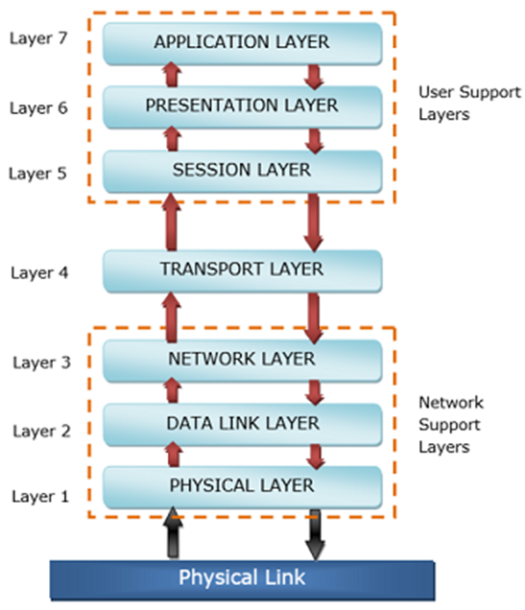
OSI MODEL.

Slide 106
OSI MODEL.
The Open Systems Interconnection model (OSI model) is a conceptual model that characterizes and standardizes the communication functions of a telecommunication or computing system without regard to its underlying internal structure and technology.
Its goal is the interoperability of diverse communication systems with standard communication protocols.

Slide 107
OSI MODEL CONT…
The model partitions the flow of data in a communication system into seven abstraction layers, from the physical implementation of transmitting bits across a communications medium to the highest-level representation of data of a distributed application.
Each intermediate layer serves a class of functionality to the layer above it and is served by the layer below it. Classes of functionality are realized in software by standardized communication protocols.

Slide 108
OSI MODEL CONT…
The OSI model was defined in ISO/IEC 7498 which consists of the following parts:
ISO/IEC 7498-1 The Basic Model
ISO/IEC 7498-2 Security Architecture
ISO/IEC 7498-3 Naming and addressing
ISO/IEC 7498-4 Management framework

Slide 109
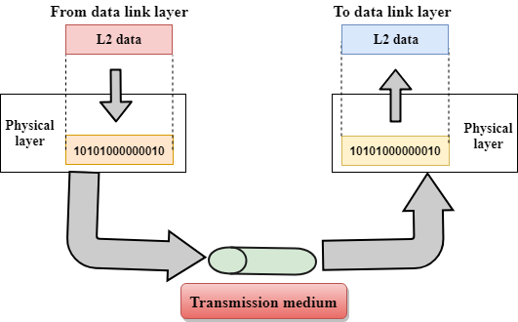
OSI MODEL CONT…
Physical Layer 1:
The physical layer is responsible for the transmission and reception of unstructured raw data between a device and a physical transmission medium.
It converts the digital bits into electrical, radio, or optical signals.

Slide 110

OSI MODEL CONT…
Physical Layer 1
Functions of a Physical layer:
Line Configuration: It defines the way how two or more devices can be connected physically.
Data Transmission: It defines the transmission mode whether it is simplex, half-duplex or full-duplex mode between the two devices on the network.
Topology: It defines the way how network devices are arranged.
Signals: It determines the type of the signal used for transmitting the information.

Slide 111
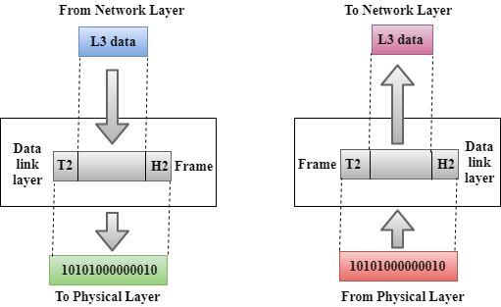
OSI MODEL CONT…
Data Link Layer 2
The data link layer provides node-to-node data transfer—a link between two directly connected nodes.
It defines the protocol to establish and terminate a connection between two physically connected devices and defines the protocol for flow control between them.

Slide 112

OSI MODEL CONT…
Data Link Layer 2
It contains two sub-layers:
Logical Link Control Layer
Media Access Control Layer

Slide 113
OSI MODEL CONT…
Data Link Layer 2
It contains two sub-layers:
Logical Link Control Layer
It is responsible for transferring the packets to the Network layer of the receiver that is receiving.
It identifies the address of the network layer protocol from the header.
It also provides flow control.

Slide 114
OSI MODEL CONT…
Data Link Layer 2
It contains two sub-layers:
Media Access Control Layer
A Media access control layer is a link between the Logical Link Control layer and the network's physical layer.
It is used for transferring the packets over the network.

Slide 115
OSI MODEL CONT…
Data Link Layer 2
Functions of the Data-link layer
Framing: The data link layer translates the physical's raw bit stream into packets known as Frames. It adds the header and trailer to the frame. The header which is added to the frame contains the hardware destination and source address.

Slide 116
OSI MODEL CONT…
Data Link Layer 2
Functions of the Data-link layer
Physical Addressing: The Data link layer adds a header to the frame that contains a destination address. The frame is transmitted to the destination address mentioned in the header.

Slide 117
OSI MODEL CONT…
Data Link Layer 2
Functions of the Data-link layer
Access Control: When two or more devices are connected to the same communication channel, then the data link layer protocols are used to determine which device has control over the link at a given time.

Slide 118
OSI MODEL CONT…
Data Link Layer 2
Functions of the Data-link layer
Error Control: Error control is achieved by adding a calculated value CRC (Cyclic Redundancy Check) that is placed to the Data link layer's trailer which is added to the message frame before it is sent to the physical layer.
If any error seems to occur, then the receiver sends the acknowledgment for the retransmission of the corrupted frames.

Slide 119
OSI MODEL CONT…
Data Link Layer 2
Functions of the Data-link layer
Flow Control: It is the technique through which the constant data rate is maintained on both the sides so that no data get corrupted.
It ensures that the transmitting station such as a server with higher processing speed does not exceed the receiving station, with lower processing speed.

Slide 120
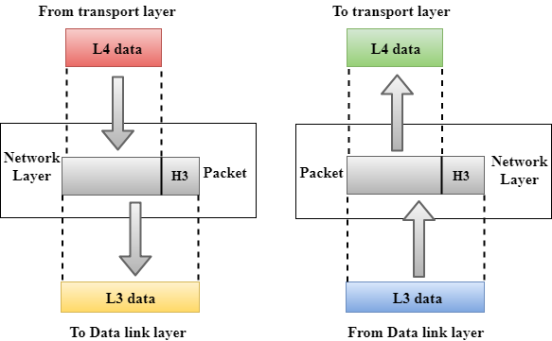
OSI MODEL CONT…
Network Layer 3
The network layer provides the functional and procedural means of transferring packets from one node to another connected in different networks.

Slide 121
OSI MODEL CONT…
Network Layer 3
It manages device addressing, tracks the location of devices on the network.
It determines the best path to move data from source to the destination based on the network conditions, the priority of service, and other factors.

Slide 122
OSI MODEL CONT…
Network Layer 3
Routers are the layer 3 devices, they are specified in this layer and used to provide the routing services within an internetwork.
The protocols used to route the network traffic are known as Network layer protocols. Examples of protocols are IPv4 and Ipv6.

Slide 123
OSI MODEL CONT…
Network Layer 3
Functions of Network Layer:
Internetworking: An internetworking is the main responsibility of the network layer. It provides a logical connection between different devices.
Addressing: A Network layer adds the source and destination address to the header of the frame. Addressing is used to identify the device on the internet.

Slide 124
OSI MODEL CONT…
Network Layer 3
Functions of Network Layer:
Routing: Routing is the major component of the network layer, and it determines the best optimal path out of the multiple paths from source to the destination.
Packetizing: A Network Layer receives the packets from the upper layer and converts them into packets. This process is known as Packetizing. It is achieved by internet protocol (IP).

Slide 125
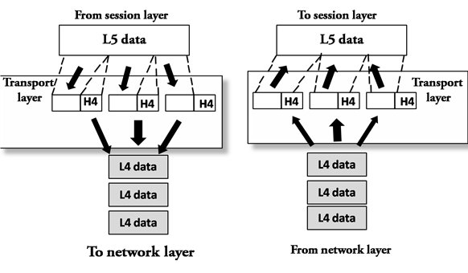
OSI MODEL CONT…
Transport Layer 4
It is responsible for the delivery of the entire message from source-to-destination (end-to-end) is the responsibility of this layer. Data is known as Segments in this layer.

Slide 126
OSI MODEL CONT…
Transport Layer 4
The two protocols used in this layer are:
Transmission Control Protocol (TCP)
User Datagram Protocol (UDP)

Slide 127
OSI MODEL CONT…
Transport Layer 4
The two protocols used in this layer are:
Transmission Control Protocol (CONNECTION BASED)
It is a standard protocol that allows the systems to communicate over the internet.
It establishes and maintains a connection between hosts.

Slide 128
OSI MODEL CONT…
Transport Layer 4
The two protocols used in this layer are:
User Datagram Protocol (CONNECTIONLESS)
It is an unreliable transport protocol as in this case receiver does not send any acknowledgment when the packet is received, the sender does not wait for any acknowledgment.

Slide 129
OSI MODEL CONT…
Transport Layer 4
Functions of Transport Layer:
Service-point addressing: The transport layer adds the header that contains the address known as a service-point address or port address. The responsibility of the network layer is to transmit the data from one computer to another computer and to transmit the message to the correct process.

Slide 130
OSI MODEL CONT…
Transport Layer 4
Functions of Transport Layer:
Segmentation and reassembly: When the transport layer receives the message from the upper layer, it divides the message into multiple segments, and each segment is assigned with a sequence number that uniquely identifies each segment.
When the message has arrived at the destination, then the transport layer reassembles the message based on their sequence numbers.

Slide 131
OSI MODEL CONT…
Transport Layer 4
Functions of Transport Layer:
Connection control: Transport layer provides two services Connection-oriented service and connectionless service.
A connectionless service treats each segment as an individual packet, and they all travel in different routes to reach the destination.
A connection-oriented service makes a connection with the transport layer at the destination machine before delivering the packets.

Slide 132
OSI MODEL CONT…
Transport Layer 4
Functions of Transport Layer:
Flow control: The transport layer also is responsible for flow control but it is performed end-to-end rather than across a single link.

Slide 133
OSI MODEL CONT…
Transport Layer 4
Functions of Transport Layer:
Error control: Error control is performed end-to-end rather than across the single link. The sender transport layer ensures that message reach at the destination without any error.

Slide 134
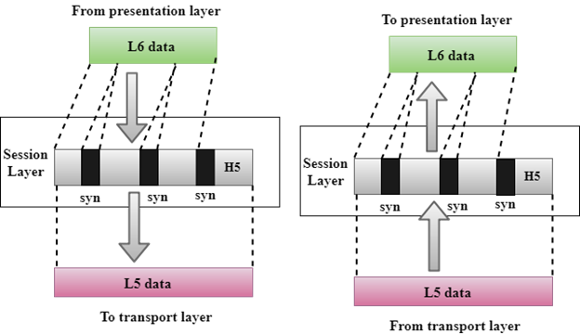
OSI MODEL CONT…
Session layer 5
The Session layer is used to establish, maintain and synchronizes the interaction between communicating devices.

Slide 135
OSI MODEL CONT…
Session layer 5
Functions of Session layer:
Dialog control: Session layer acts as a dialog controller that creates a dialog between two processes or we can say that it allows the communication between two processes which can be either half-duplex or full-duplex.

Slide 136
OSI MODEL CONT…
Session layer 5
Functions of Session layer:
Synchronization: Session layer adds some checkpoints when transmitting the data in a sequence. If some error occurs in the middle of the transmission of data, then the transmission will take place again from the checkpoint. This process is known as Synchronization and recovery.

Slide 137
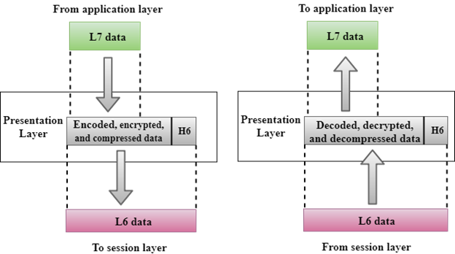
OSI MODEL CONT…
Presentation layer 6
The presentation layer ensures that communicating machines can interoperate properly. The data received by the receiver should be understandable and it is the responsibility of this layer. If syntax between the two communicating users is different then this layer operates as a translator.

Slide 138
OSI MODEL CONT…
Presentation layer 6
Functions of Presentation layer:
Translation: Different computers use different encoding methods, the presentation layer handles the interoperability between the different encoding methods.
It converts the data from sender-dependent format into a common format and changes the common format into receiver-dependent format at the receiving end.

Slide 139
OSI MODEL CONT…
Presentation layer 6
Functions of Presentation layer:
Encryption: Encryption is needed to maintain privacy. Encryption is a process of converting the sender-transmitted information into another form and sends the resulting message over the network.

Slide 140
OSI MODEL CONT…
Presentation layer 6
Functions of Presentation layer:
Compression: Data compression is a process of compressing the data, i.e., it reduces the number of bits to be transmitted. Data compression is very important in multimedia such as text, audio, video.

Slide 141
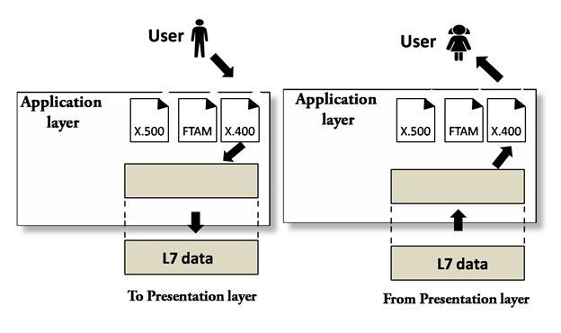
OSI MODEL CONT…
Application layer 7
This layer is implemented by the network application.
This layer allows the user to access the network. The data that has to be transferred over the network is produced by these applications.
The UI (user interface) and maintenance for services such as e-mail and remote file access control are implemented through this layer.

Slide 142
OSI MODEL CONT…
Application layer 7
Functions of Application layer:
File transfer, access, and management (FTAM): An application layer allows a user to access the files in a remote computer, to retrieve the files from a computer and to manage the files in a remote computer.

Slide 143
OSI MODEL CONT…
Application layer 7
Functions of Application layer:
Mail services: An application layer provides the facility for email forwarding and storage.

Slide 144
OSI MODEL CONT…
Application layer 7
Functions of Application layer:
Directory services: An application provides the distributed database sources and is used to provide that global information about various objects.

Slide 145
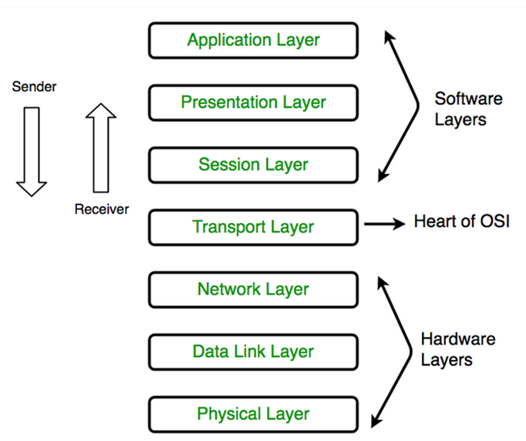
OSI MODEL CONT…
How communication is transmitted.

Slide 146
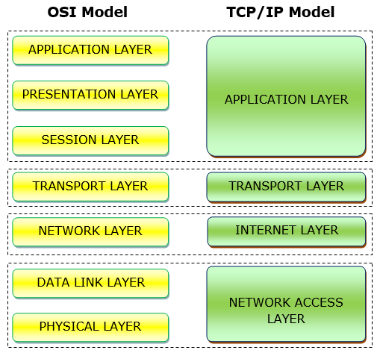
SIMILARITIES BETWEEN OSI AND TCP / IP MODEL.
Both the reference models are based upon layered architecture.
The layers in the models are compared with each other.

Slide 147
SIMILARITIES BETWEEN OSI AND TCP / IP MODEL.
TCP/IP is a progressive step from the standard OSI version of traffic flow.

Slide 148
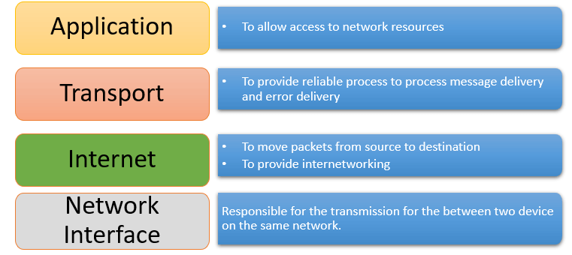

TCP/IP MODEL

Slide 149

TCP/IP MODEL
What is TCP/IP?
The Transmission Control Protocol/Internet Protocol is a collection of different communication protocols that support and define how network-enabled devices interconnect with each other over an IP-based network.
At its heart are two key protocols: TCP and IP. TCP/IP makes the internet possible.

Slide 150
TCP/IP MODEL CONT…
What is TCP/IP?
TCP/IP defines the way data is shared between network-enabled devices by defining the end-to-end communication process.
It manages how the message is broken down into packets of data, which are sometimes known as datagrams.
TCP/IP also determines how the packet is addressed and transmitted, routed, and received in the most efficient route across a network.

Slide 151

TCP/IP MODEL CONT…
What is TCP/IP?
The TCP/IP model is designed to be stateless. This design means the network stack treats each request as new because it isn't related to the previous request.
One part of the TCP/IP model isn't stateless. The transport layer operates in a stateful mode because it maintains a connection until all the packets in the message are received.

Slide 152
TCP/IP MODEL CONT…
Who owns TCP/IP?
TCP/IP is an open standard.
It's governed, but it's not owned by any one organization, so it works with all operating systems, networks, and hardware.

Slide 153
TCP/IP MODEL LAYERS CONT…
TCP/IP model layers
The TCP/IP model is made up of four distinct layers. Each layer uses a different type of protocol. Notice how the TCP/IP model is similar to the Internet Protocol suite discussed earlier.
Application layer 4
Transport layer 3
Internet layer 2
Network access layer 1

Slide 154

TCP/IP MODEL LAYERS CONT…
TCP/IP model layers
Application layer 4:
The application layer is responsible for determining which communication protocols are used.

Slide 155
TCP/IP MODEL LAYERS CONT…
TCP/IP model layers
Application layer 4:
The functions of the application layer are −
It facilitates the user to use the services of the network.
It is used to develop network-based applications.
It provides user services like user login, naming network devices, formatting messages, and e-mails, transfer of files etc.
It is also concerned with error handling and recovery of the message as a whole.

Slide 156
TCP/IP MODEL LAYERS CONT…
TCP/IP model layers
Application layer 4 protocols:
This layer includes HyperText Transfer Protocol (HTTP), DNS, File Transfer Protocol (FTP), Internet Message Access Protocol (IMAP), Lightweight Directory Access Protocol (LDAP), Post Office Protocol (POP), Simple Mail Transfer Protocol (SMTP), Simple Network Management Protocol (SNMP), Secure Shell (SSH), Telnet, and TLS/SSL.

Slide 157
TCP/IP MODEL LAYERS CONT…
TCP/IP model layers
Transport layer 3:
This layer splits the application data into manageable ordered chunks by using the right port for the application protocol that's used.

Slide 158
TCP/IP MODEL LAYERS CONT…
TCP/IP model layers
Transport layer 3:
The functions of the transport layer are −
It facilitates the communicating hosts to carry on a conversation.
It provides an interface for the users to the underlying network.
It can provide for a reliable connection. It can also carry out error checking, flow control, and verification.

Slide 159
TCP/IP MODEL LAYERS CONT…
TCP/IP model layers
Transport layer 3 protocols:
The protocols associated with this layer are TCP, User Datagram Protocol (UDP) and Stream Control Transmission Protocol, (SCTP)

Slide 160
TCP/IP MODEL LAYERS CONT…
TCP/IP model layers
Internet layer 2:
Also known as the network layer, this layer ensures the data packet gets to its destination.

Slide 161
TCP/IP MODEL LAYERS CONT…
TCP/IP model layers
Internet layer 2:
The main functions of the internet layer are −
It transmits data packets to the link layer.
It routes each of the data packets independently from the source to the destination, using the optimal route.
It reassembles the out-of-order packets when they reach the destination.
It handles the error in transmission of data packets and fragmentation of data packets.

Slide 162
TCP/IP MODEL LAYERS CONT…
TCP/IP model layers
Internet layer 2 protocols:
The protocols associated with this layer are IP, IPv4, IPv6, Internet Control Message Protocol (ICMP), Internet Protocol Security (IPsec) and IGMP, RARP, and ARP.

Slide 163
TCP/IP MODEL LAYERS CONT…
TCP/IP model layers
Network access layer:
This layer is responsible for defining how the data is sent across the network.

Slide 164
TCP/IP MODEL LAYERS CONT…
TCP/IP model layers
Network access layer:
The functions of this layer are:
It defines how bits are to be encoded into optical or electrical pulses.
It accepts IP packets from the network layer and encapsulates them into frames. It synchronizes the transmission of the frames as well as the bits making up the frames, between the sender and the receiver.
It states the transmission mode, i.e. simplex, half duplex or full duplex
It states the topology of the network, i.e. bus, star, ring etc.

Slide 165
TCP/IP MODEL LAYERS CONT…
TCP/IP model layers
Network access layer 1:
The protocols associated with this layer are MAC, Ethernet, digital subscriber line (DSL), and Integrated Services Digital Network (ISDN).

Slide 166
TCP/IP MODEL LAYERS CONT…
TCP/IP is needed to ensure that information reaches its intended destination. Without TCP/IP, packets of information would never arrive where they need to be and the Internet wouldn’t be the pool of useful information that we know it to be today.

Slide 167
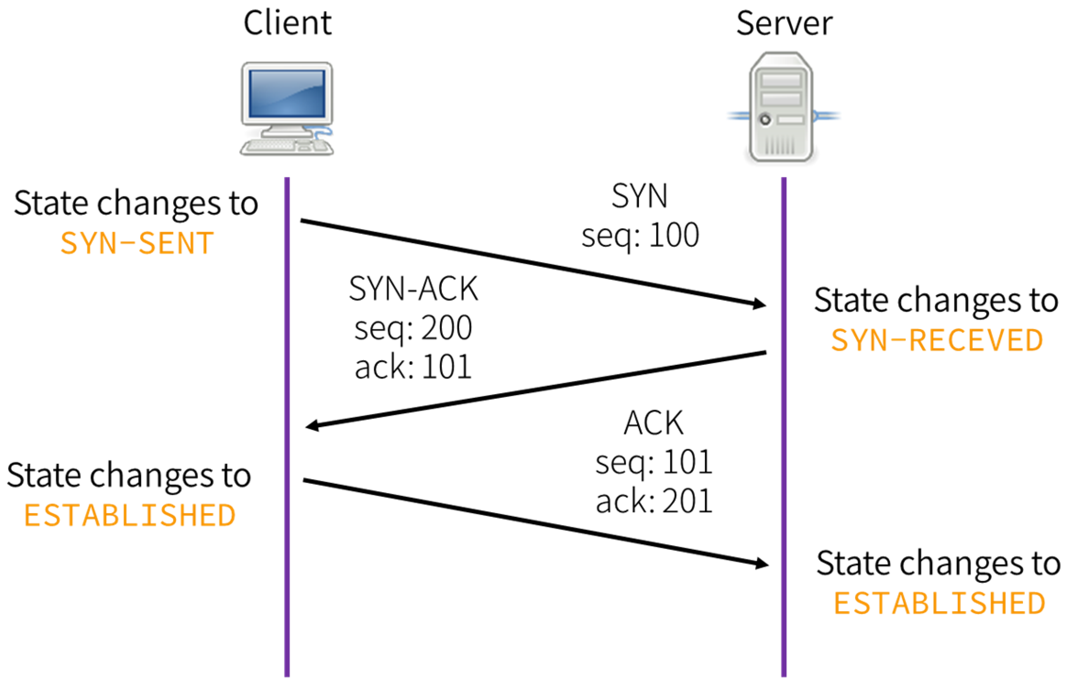
THREE WAY HANDSHAKE

Slide 168
THREE WAY HANDSHAKE
Three way handshake if the process of connection based communication i.e. TCP. It ensures a connection is established before transmission.
Let’s learn how the process occurs.

Slide 169
THREE WAY HANDSHAKE
The process starts with a SYN packet.
This SYN packet starts the handshake process by telling the receiving system that another system wants its attention.

Slide 170
THREE WAY HANDSHAKE
The receiving system then replies to the originating system with a SYN-ACK response.
A SYN-ACK response is an acknowledgment response to the original SYN packet.

Slide 171
THREE WAY HANDSHAKE
Once the original sender receives the SYN-ACK response, it in turn responds with an ACK packet to verify that it has received the SYN-ACK and is ready to communicate via TCP.

Slide 172

Usable attacks can all be traced back to a specific layer or layers of the OSI model.

Slide 173
LAYERED SECURITY CONSIDERATIONS
Layered security approaches the models by ensuring security considerations are executed at the layer level.

Slide 174
LAYERED SECURITY CONSIDERATIONS
Physical Layer
In case of any cyber danger, it is recommended to unplug the cable from the primary system.
Safeguarding this layer needs bio-metric security, camera-based surveillance, key cards, and other physical monitoring.

Slide 175
LAYERED SECURITY CONSIDERATIONS
Data Link Layer
Vulnerabilities that can be used and attacks that can be made in this layer are MAC address spoofing as well as Virtual-LAN circumvention.
Common security mechanisms are MAC address filtering, assessment of wireless applications, checking of proper data encryption standards.

Slide 176
LAYERED SECURITY CONSIDERATIONS
Network Layer
IP address spoofing is one of the common attack of this phase.
Strengthening this layer needs the techniques of firm anti-spoofing, proper implementation of firewalls and routing filters as well as secure routing protocols.

Slide 177
LAYERED SECURITY CONSIDERATIONS
Transport Layer
This layer needs an appropriate implementation of firewall, restrictive admission of transmission protocols, and their appropriate port number.

Slide 178
LAYERED SECURITY CONSIDERATIONS
Session Layer
In case of weak authentication methods, it can help attackers to perform a brute force.
So the effective way of securing this layer is by ensuring appropriate encrypted key exchange, along with the restriction of unsuccessful session attempts using timing methods.

Slide 179
LAYERED SECURITY CONSIDERATIONS
Presentation Layer –
It is used to standardize data with the help of various conversion schemes. But if there is poor conduct of malicious input, it can help cyber criminals exploit the system or even crash a system.
Separate sanitized input and proper input validation can help protect the system from attackers.

Slide 180
LAYERED SECURITY CONSIDERATIONS
Application Layer
Contains the UI and the closest of all layers for the user-end. The widest range of cyber attacks and security breach is possible in this layer.
It can lead to shutting down of the network, stealing of data, crashing the application, manipulating the information sent from source to destination and many more.

Slide 181
SUMMARY.
Networks are made up of various tangible elements like network devices, switches, and network routers. Other aspects, like network communication protocols and network security, protect your organization's assets and resources.
Understanding the underlying network protocols and standards and how networks communicate is an essential step in understanding cyber security.

